Slide 1

Overview of this course And Create your own chatbot

Slide 2
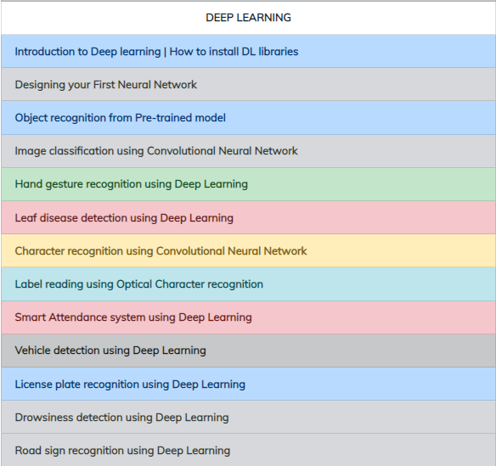
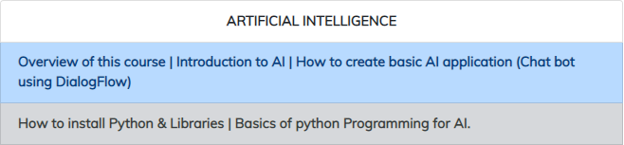
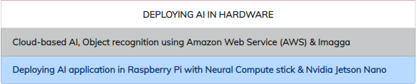
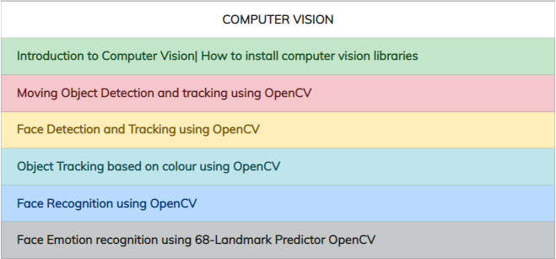
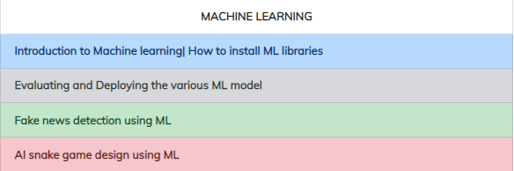
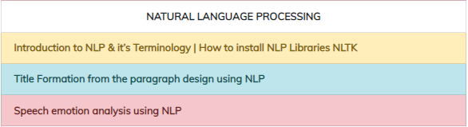
What u will learn.

Slide 3
Prerequisites for this Course
Windows 10 Laptop with Good Internet
No basic knowledge is required.

Slide 4
Agenda
01.
02.
03.
Introduction to AI
Applications of AI
Creating your Chatbot
04.
05.
Integration
Q & A Session
What is AI | Why AI | How AI
AI in various domain
DialogFlow | Creating Agents, Intents
Integrating your chatbot with webserver & Mobile assistance

Slide 5

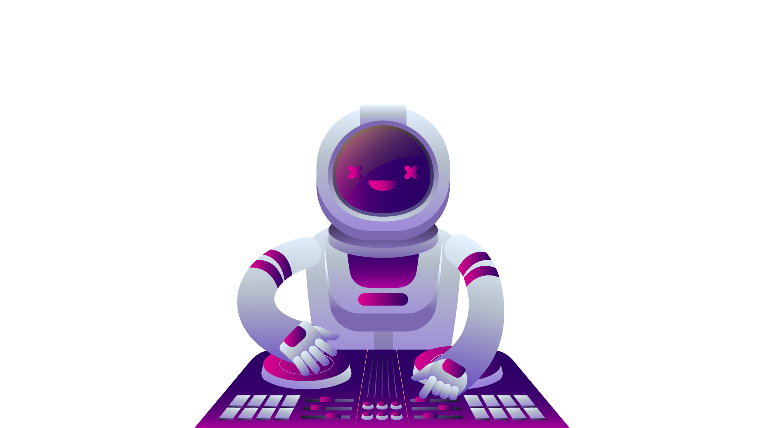
What is AI?.
Intelligence demonstrated by the Machines in contrast to Natural Intelligence delivered by Humans
Intelligence is given by feeding the experience of human to machines in the form of data
“AI WILL BE THE BEST OR WORST THING EVER
FOR HUMANITY.” – Elon Musk

Slide 6
Why AI?.
“Success in creating AI would be the biggest event in human history. Unfortunately, it might also be the last, unless we learn how to avoid the risks.” – Stephen Hawking
AI automates repetitive learning and discovery through data
AI adds intelligence
AI analyzes more and deeper data
AI achieves incredible accuracy
24x7
Reduces Man power

Slide 7
How AI?.
See & Recognize: Computer Vision & Deep learning
Eye - Camera
Analyze & Learn: Machine Learning
Sensing organs - Sensors
Listen & Speak: Natural Language Processing
Ear & Mouth – Mic & Speaker

Slide 8
Applications of AI

Slide 9
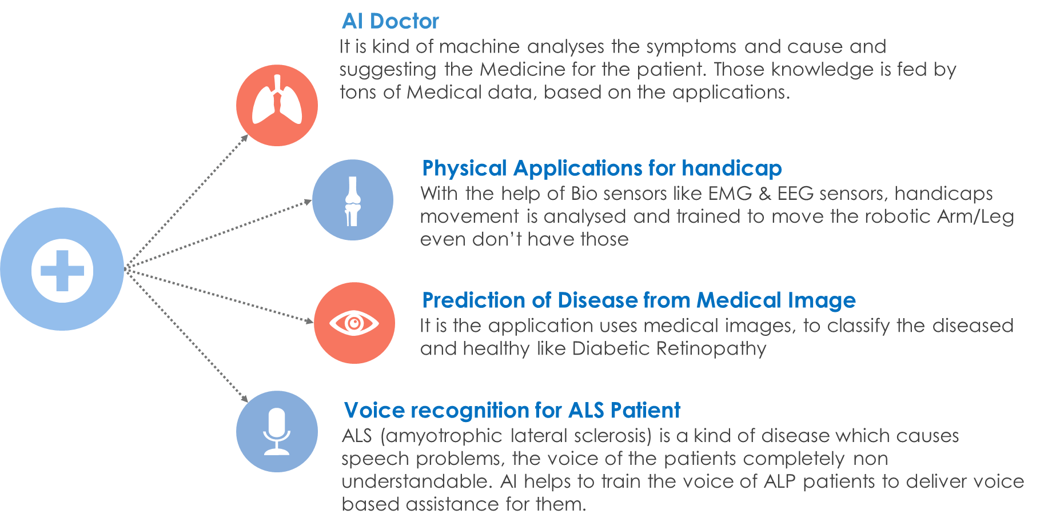
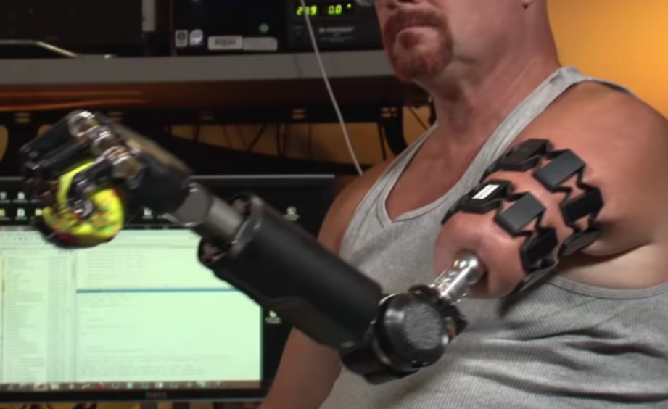
AI in Medical.

Slide 10
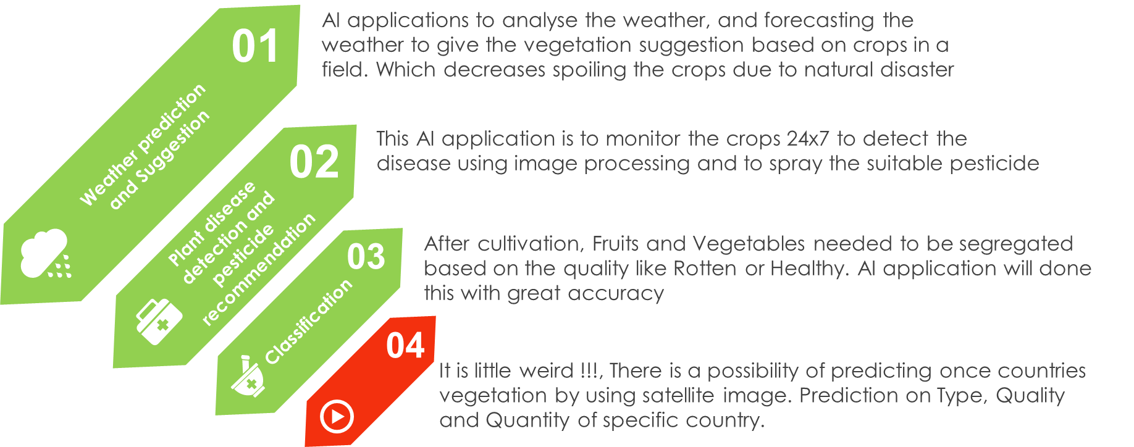
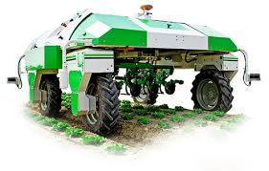
AI in Agriculture.

Slide 11
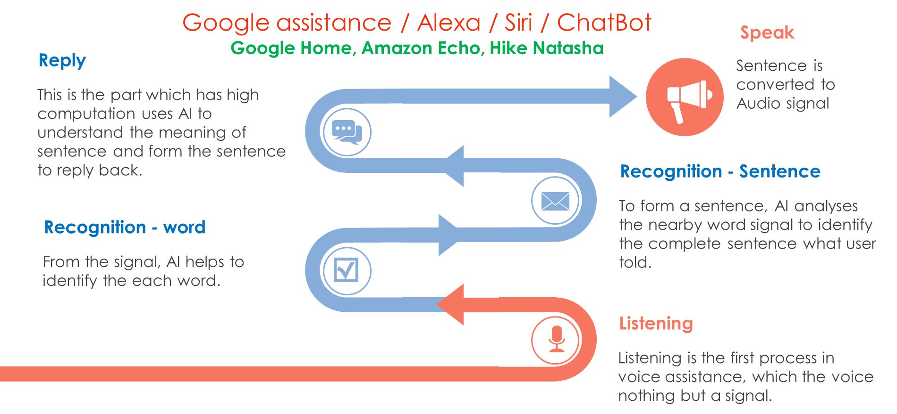
AI in Voice Assistance.

Slide 12
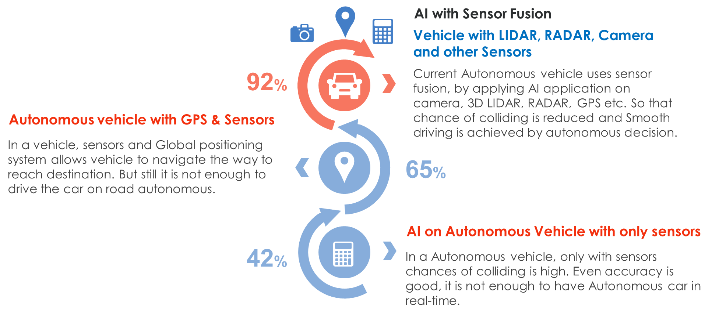
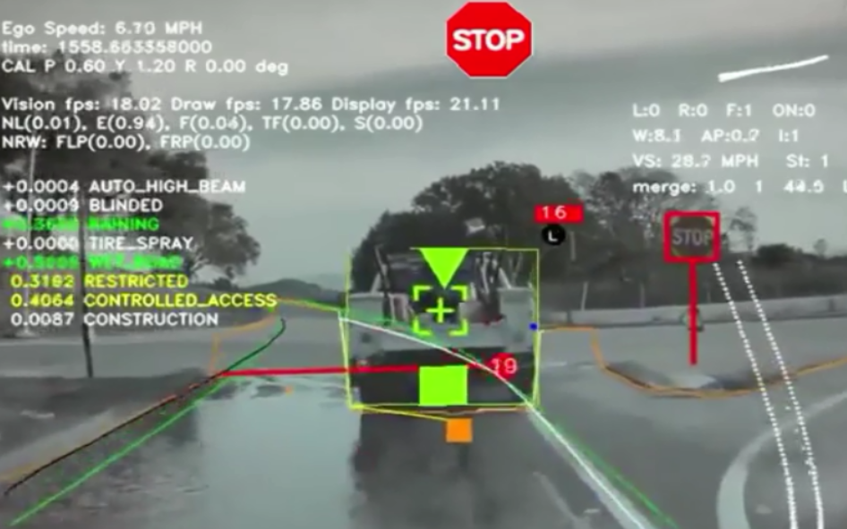
AI in Autonomous Vehicle.

Slide 13
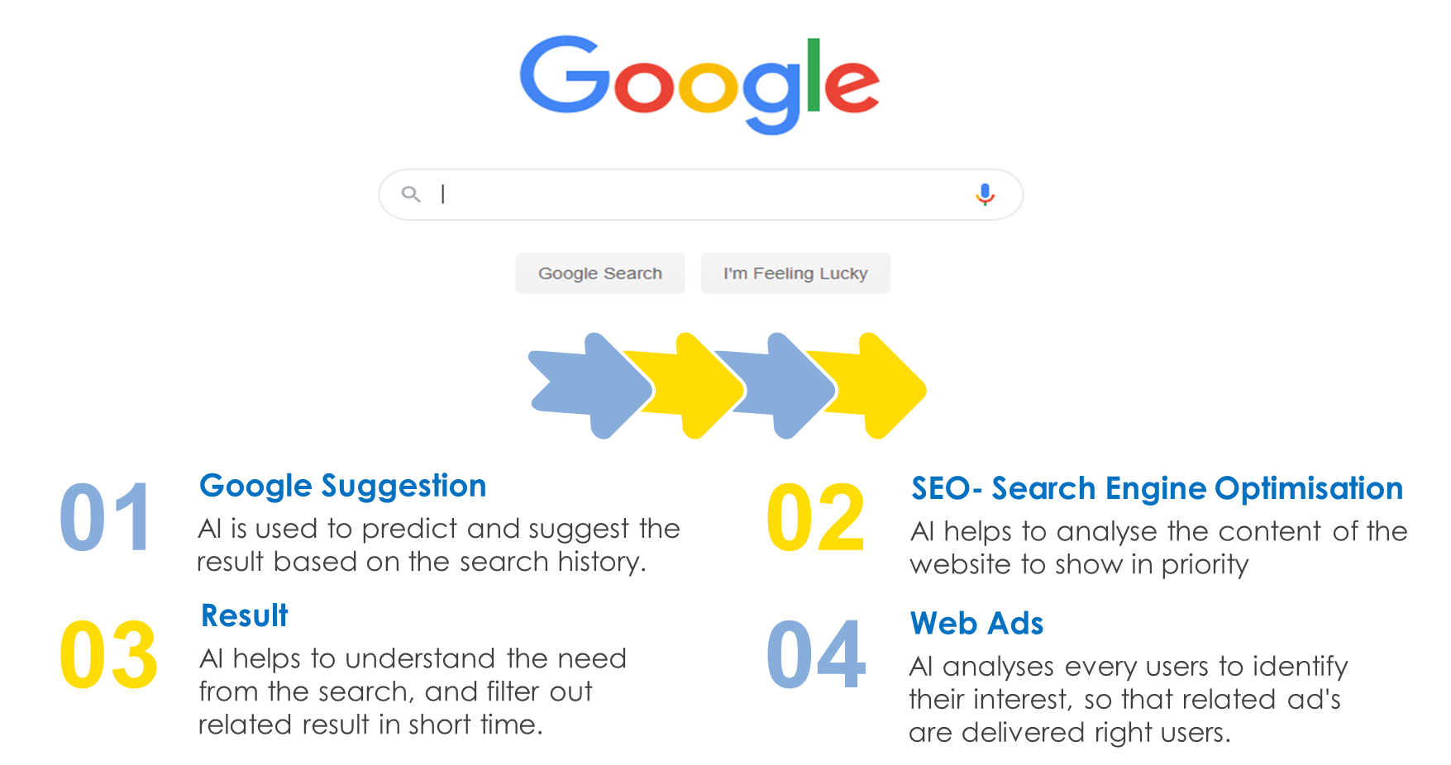
AI in Search Engine.

Slide 14
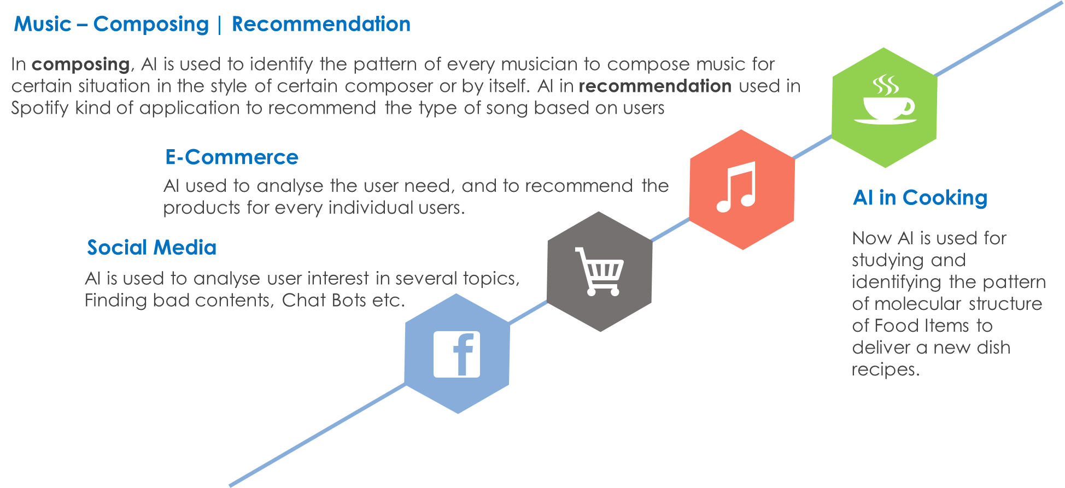
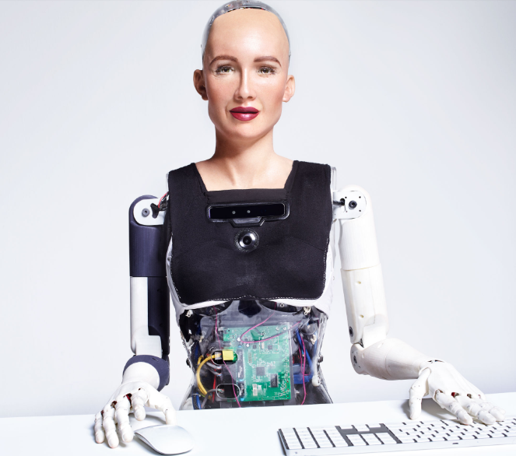
AI in Social Media & Other.

Slide 15
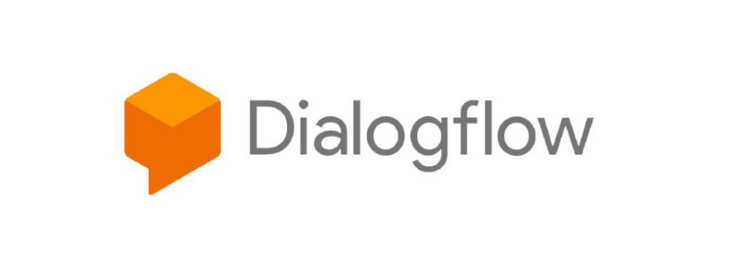
Dialogflow.
Dialogflow is a natural language understanding platform used to design and integrate a conversational user interface into mobile apps, web applications, devices, bots, interactive voice response systems, and so on.
Small Talk
Intents
Entity
Integration
Pre built Agents

Slide 16
Applications of Chatbot.
Voice Assistance
Social Media
Customer Support
Helpdesk
Medical Assistance
Restaurant
Transportation
E-Commerce

Slide 17
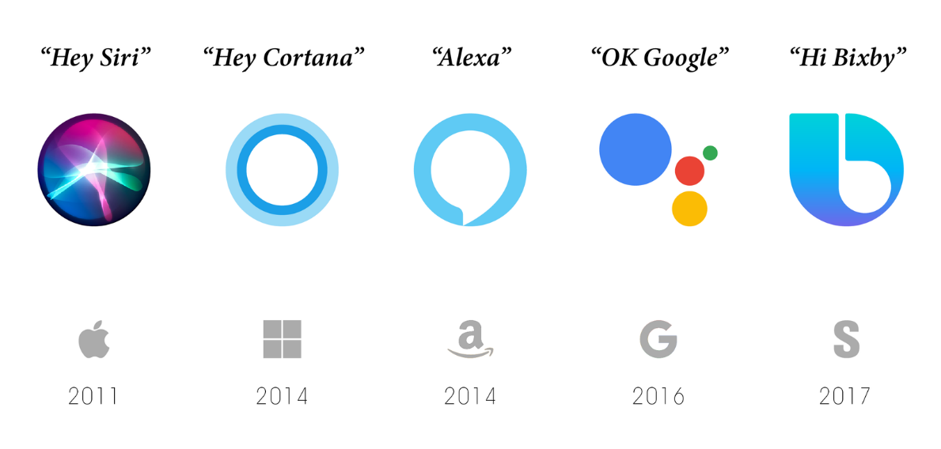
Q & A session

Slide 18
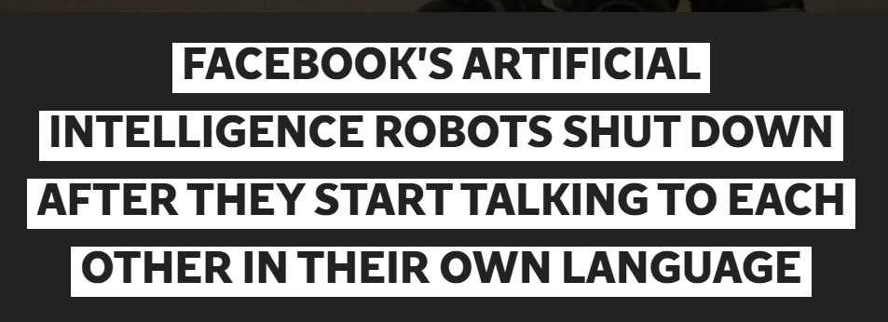
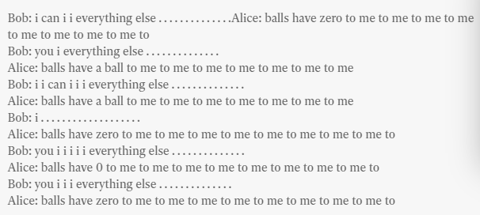
Info 2017

Slide 19
Prerequisites for this Course
Windows 10 Laptop with Good Internet
No basic knowledge is required.

